Slide 1

Lecture 17 Transactions (事务)
(Chapter 17)
Prof. Jihong Guan
Email: jhguan@tongji.edu.cn
Department of Computer Science and Technology
Tongji University

Slide 2
Outline of the Course
Part 0: Overview
  Ch1: Introduction
Part 1 Relational Databases
  Ch2: Relational model (data model, relational algebra)
  Ch3&4: SQL(Structured Query Language)
  Ch5: Advanced SQL
Part 2 Database Design
  Ch6: Database design based on E-R model
  Ch7: Relational database design
Part 3 Application Design & Development
  Ch8: Complex data types
  Ch9: Application development
Part 4 Big data analytics
  Ch10: Big data
  Ch11: Data analytics
Part 5 Data Storage & Indexing
  Ch12: Physical storage system
  Ch13: Data storage structure
  Ch14: Indexing
Part 6 Query Processing & Optimization
  Ch15: Query processing
  Ch16: Query optimization
☞ Part 7 Transaction Management
  Ch17: Transactions
  Ch18: Concurrency control
  Ch19: Recovery system
Part 8 Parallel & Distributed Database
  Ch20: Database system architecture
  Ch21-23: Parallel & distributed storage, query processing & transaction processing
Part 9
  DB Platform:OceanBase, MongoDB, Neo4J

Slide 3
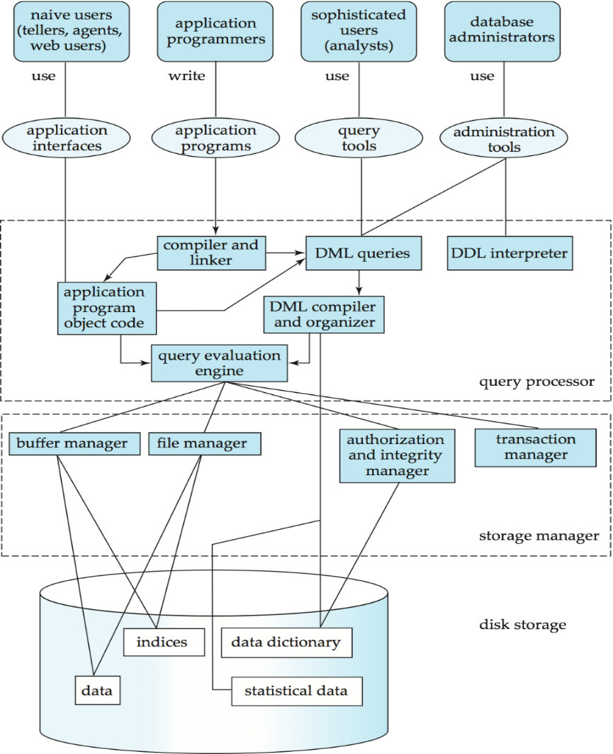
Users
Applications/tools
Database
System
Structure
DBMS
Database

Slide 4
Outline
☞ Transaction Concept
Schedules
Serializable Schedule
Recoverable Schedule
Testing for Serializability

Slide 5
Transaction Concept
A transaction is a unit of program execution consisting of multiple operations
  During transaction execution, the database may be inconsistent
  After the transaction is committed, the database must be consistent
Two main issues
  Concurrent execution of multiple transactions
  Hardware failures and system crashes

Slide 6
ACID Properties
Atomicity（原子性）
  Either all operations of the transaction are properly reflected in the database or none are
Consistency（一致性）
  Execution of a transaction in isolation preserves the consistency of the database
Isolation（隔离性）
  Although multiple transactions may execute concurrently, each transaction must be unaware of other transactions
Durability（持久性）
  After a transaction completes successfully, the changes it has made to the database persist, even if there are system failures

Slide 7
Example of Fund Transfer
A transaction to transfer $50 from account A to account B:
      1. read(A)
      2. A := A – 50
      3. write(A)
      4. read(B)
      5. B := B + 50
      6. write(B)
Consistency requirement
  The sum of A and B is unchanged by the execution of the transaction
Atomicity requirement
  If the transaction fails after step 3 and before step 6, the system should ensure that its updates are not reflected in the database. Otherwise, an inconsistency will occur

Slide 8
Example of Fund Transfer (Cont.)
Durability requirement
  Once the user was notified that the transaction has completed, the updates to the database by the transaction must persist despite failures
Isolation requirement
  If between steps 3 and 6, another transaction is allowed to access the partially updated database, it will see an inconsistent database
  Can be ensured trivially by running transactions serially, i.e., one after the other. However, executing multiple transactions concurrently has significant benefits

Slide 9
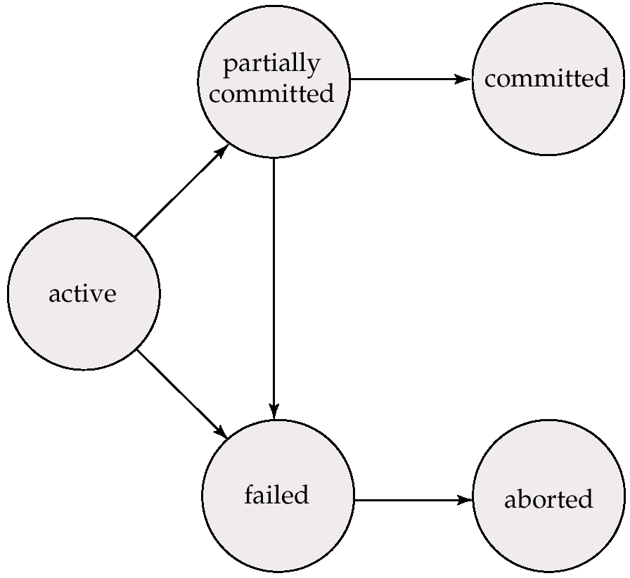
Transaction State
Active(活跃)
  The initial state. The transaction stays in this state while it is executing
Partially committed(部分提交)
  After the final statement has been executed
Failed(失败)
  After discovering that normal execution can no longer proceed
Aborted(中止)
  After the transaction has been rolled back and the database restored to its state prior to the start of the transaction
  Restart the transaction – only if no internal logical error happens in the transaction
  Kill the transaction – problems arising with the transaction, input data, no desirable data found in the database
Committed(提交)
  After successful completion

Slide 10
Outline
Transaction Concept
☞ Schedules
Serializable Schedule
Recoverable Schedule
Testing for Serializability

Slide 11
Concurrent Executions
Concurrent execution
  Multiple transactions are allowed to run concurrently in the system
  Advantages
    Increase processor and disk utilization
    Reduce average response time
Concurrency control
  Mechanisms to achieve isolation, i.e., to control the interaction among the concurrent transactions in order to prevent them from destroying the consistency of the database

Slide 12
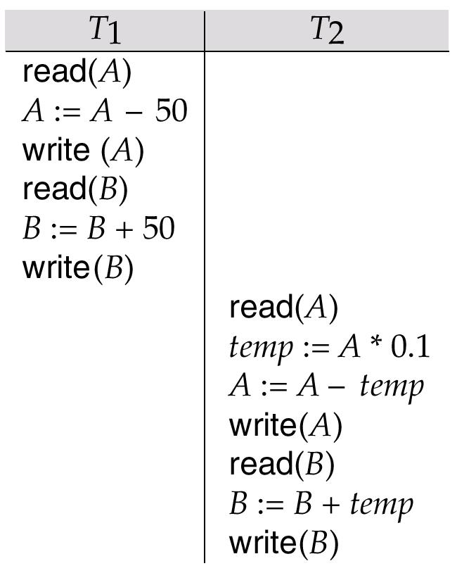
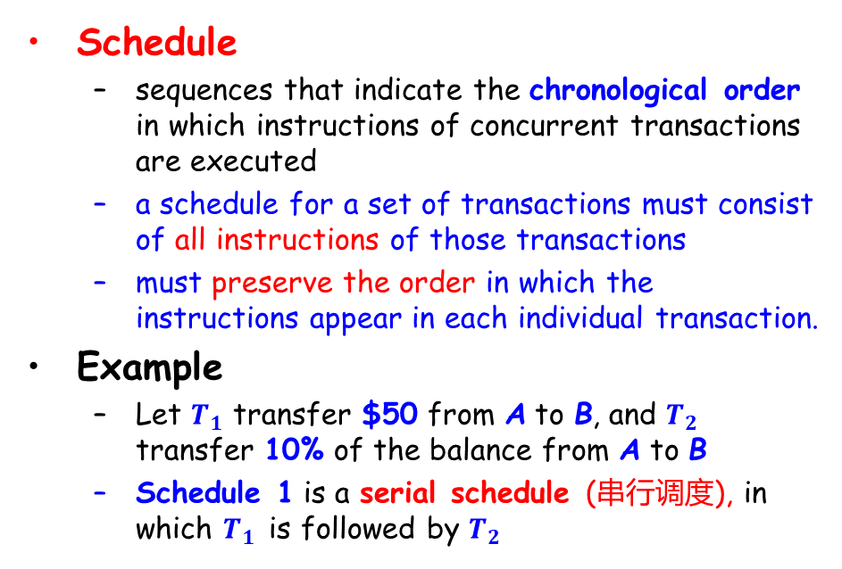
Schedules
Schedule
  sequences that indicate the chronological order in which instructions of concurrent transactions are executed
  a schedule for a set of transactions must consist of all instructions of those transactions
  must preserve the order in which the instructions appear in each individual transaction.
Example
  Let $T_{1}$ transfer $50 from A to B, and $T_{2}$ transfer 10% of the balance from A to B
  Schedule 1 is a serial schedule (串行调度), in which $T_{1}$ is followed by $T_{2}$
Schedule 1

Slide 13
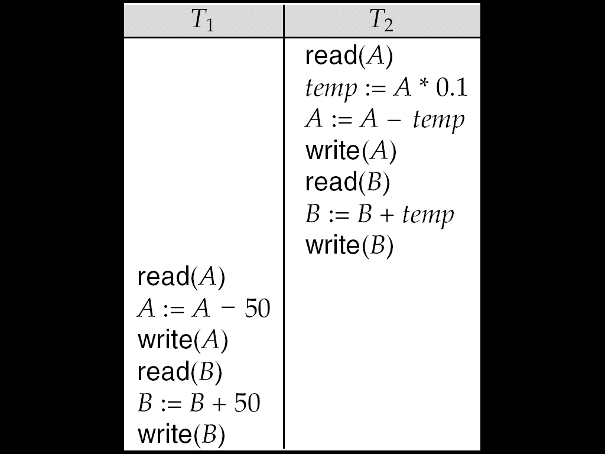

Example Schedule (Cont.)
Another serial schedule where $T_{2}$ is followed by $T_{1}$
Schedule 1
Schedule 2

Slide 14
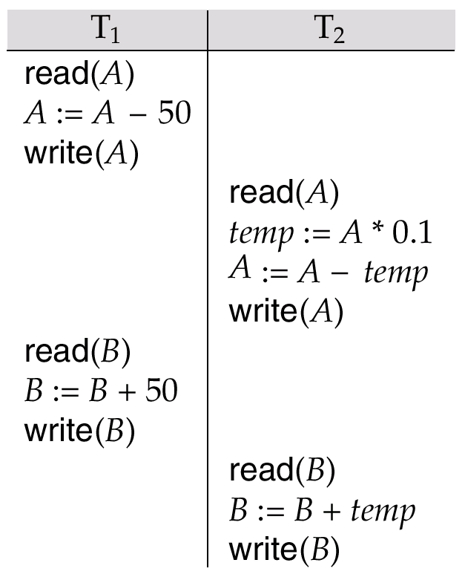
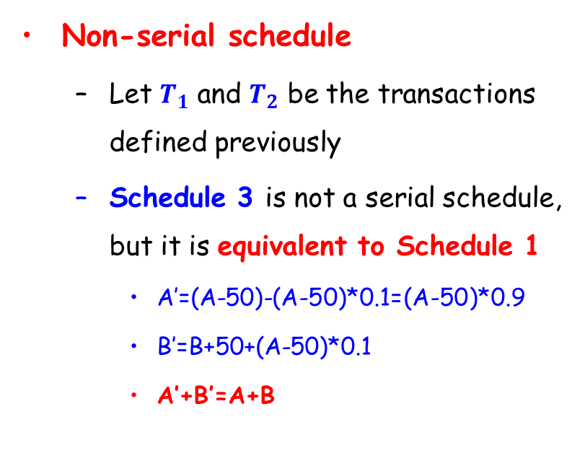
Example Schedule (Cont.)
Non-serial schedule
  Let $T_{1}$ and $T_{2}$ be the transactions defined previously
  Schedule 3 is not a serial schedule, but it is equivalent to Schedule 1
    A’=(A-50)-(A-50)*0.1=(A-50)*0.9
    B’=B+50+(A-50)*0.1
    A’+B’=A+B
Schedule 3

Slide 15
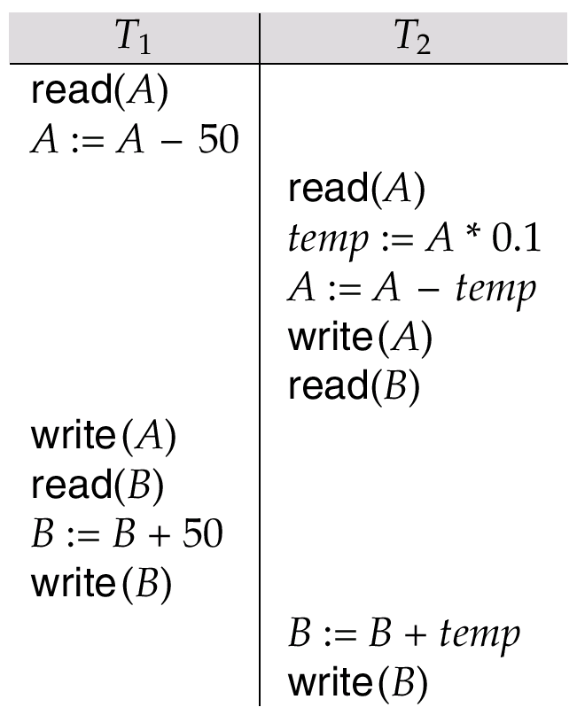
Example Schedule (Cont.)
The following concurrent schedule does not preserve the value of the sum A + B.
  A’=A-50
  B’=B+A*0.1
  A’+B’ = A+B-50+A*0.1 ≠ A+B
Schedule 4

Slide 16
Outline
Transaction Concept
Schedules
☞ Serializable Schedule
Recoverable Schedule
Testing for Serializability

Slide 17
Serializability（可串行化）
Assumption
  Each transaction preserves database consistency, thus serial execution of a set of transactions preserves database consistency
Serializability
  A schedule is serializable if it is equivalent to a serial schedule
    Conflict serializability（冲突可串行性）
    View serializability（视图可串行性）
Note
  We ignore operations other than read and write instructions. Our simplified schedules consist of only read and write instructions

Slide 18
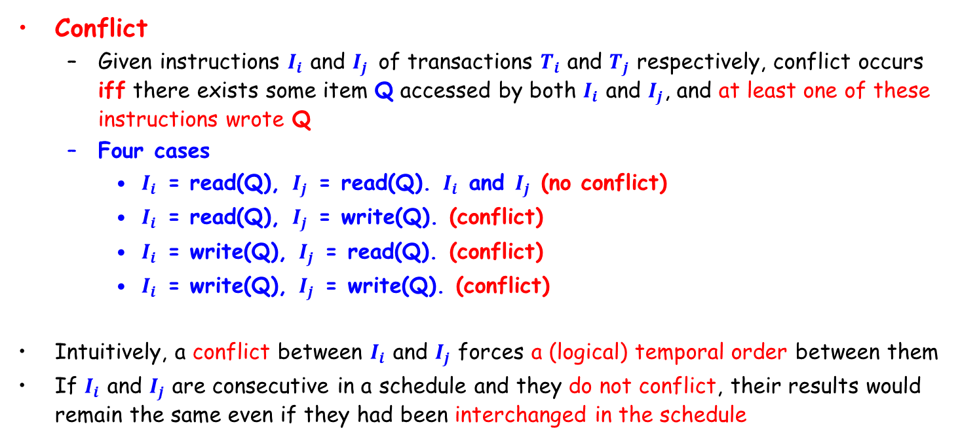
Conflict Serializability
Conflict
  Given instructions $I_{i}$ and $I_{j}$ of transactions $T_{i}$ and $T_{j}$ respectively, conflict occurs iff there exists some item Q accessed by both $I_{i}$ and $I_{j}$, and at least one of these instructions wrote Q
  Four cases
    $I_{i}$ = read(Q), $I_{j}$ = read(Q). $I_{i}$ and $I_{j}$ (no conflict)
    $I_{i}$ = read(Q), $I_{j}$ = write(Q). (conflict)
    $I_{i}$ = write(Q), $I_{j}$ = read(Q). (conflict)
    $I_{i}$ = write(Q), $I_{j}$ = write(Q). (conflict)
Intuitively, a conflict between $I_{i}$ and $I_{j}$ forces a (logical) temporal order between them
If $I_{i}$ and $I_{j}$ are consecutive in a schedule and they do not conflict, their results would remain the same even if they had been interchanged in the schedule

Slide 19
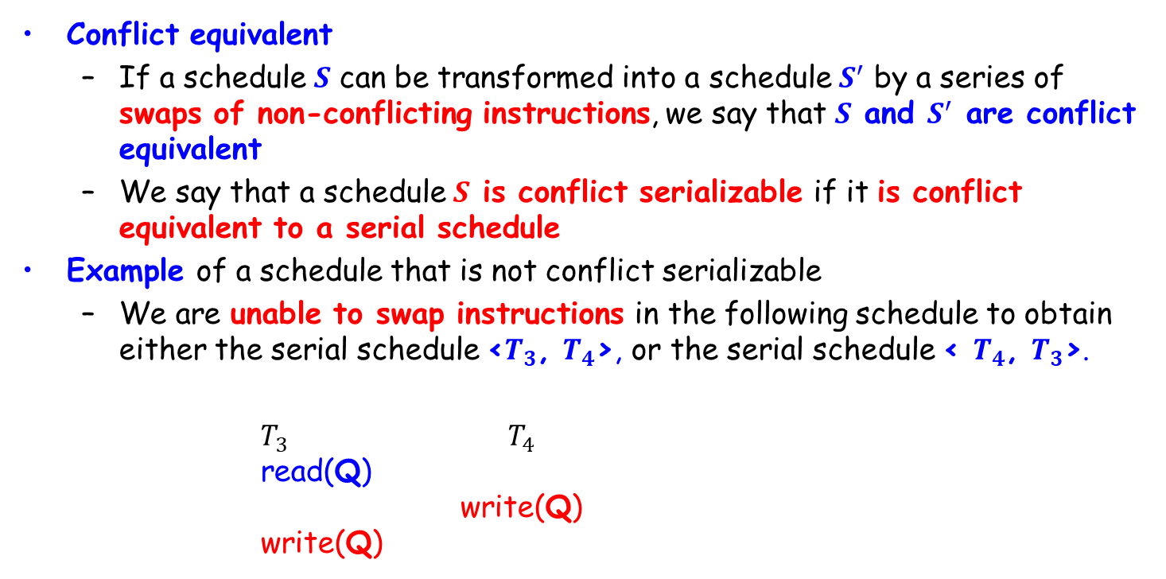
Conflict Serializability (Cont.)
Conflict equivalent
  If a schedule $S$ can be transformed into a schedule $S^{′}$ by a series of swaps of non-conflicting instructions, we say that $S$ and $S^{′}$ are conflict equivalent
  We say that a schedule $S$ is conflict serializable if it is conflict equivalent to a serial schedule
Example of a schedule that is not conflict serializable
  We are unable to swap instructions in the following schedule to obtain either the serial schedule <$T_{3}$, $T_{4}$>, or the serial schedule < $T_{4}$, $T_{3}$>.
$T_{3}$ $T_{4}$
read(Q)
write(Q)
write(Q)

Slide 20
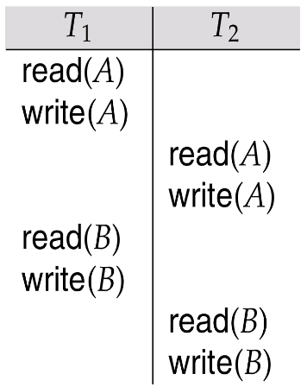

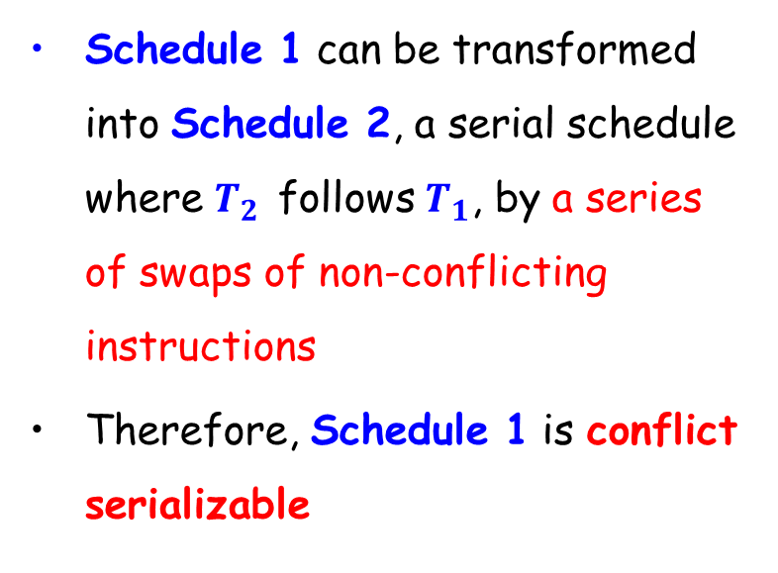
Conflict Serializability (Cont.)
Schedule 1 can be transformed into Schedule 2, a serial schedule where $T_{2}$ follows $T_{1}$, by a series of swaps of non-conflicting instructions
Therefore, Schedule 1 is conflict serializable
Read(A)
Write(A)
Read(B)
Write(B)
Schedule 1
Schedule 2

Slide 21
Conflict Serializability (Cont.)
Example
Sc1=r1(A)w1(A)r2(A)w2(A)r1(B)w1(B)r2(B)w2(B)
  Swap w2(A) and r1(B)w1(B), then we have
  r1(A)w1(A)r2(A)r1(B)w1(B)w2(A)r2(B)w2(B)
  Swap r2(A) and r1(B)w1(B), then：
  Sc2＝r1(A)w1(A)r1(B)w1(B) r2(A)w2(A)r2(B)w2(B)
  Sc2 is equivalent to a serializable schedule T₁,T₂
  Then Sc1 is conflict serializable

Slide 22
Conflict Serializability (Cont.)
A conflict serializable schedule is a serializable schedule, but a serializable schedule is not always conflict serializable.
E.g., three transactions
T1=W1(Y)W1(X)，T2=W2(Y)W2(X)，T3=W3(X)
  L1=W1(Y)W1(X)W2(Y)W2(X)W3(X) is serializable
  L2=W1(Y)W2(Y)W2(X)W1(X)W3(X) is not equivalent to L1, and not conflict serializable.
  L2 is serializable, the result of the schedule is equivalent to L1(final write X is from T3, final write Y is from T2)

Slide 23
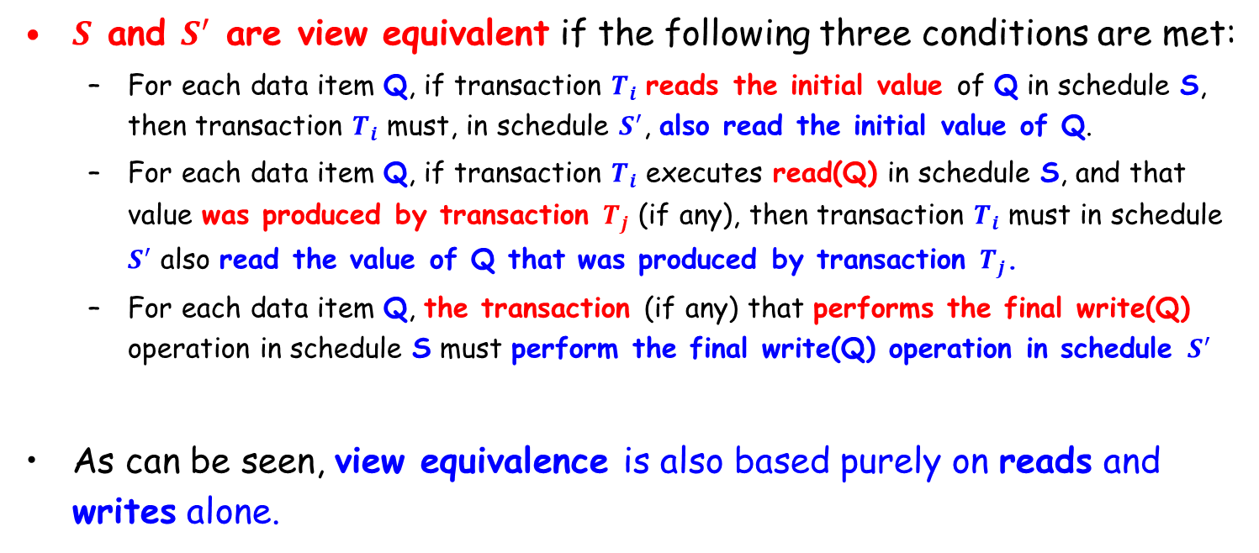
View Serializability
$S$ and $S^{′}$ are view equivalent if the following three conditions are met:
  For each data item Q, if transaction $T_{i}$ reads the initial value of Q in schedule S, then transaction $T_{i}$ must, in schedule $S^{′}$, also read the initial value of Q.
  For each data item Q, if transaction $T_{i}$ executes read(Q) in schedule S, and that value was produced by transaction $T_{j}$ (if any), then transaction $T_{i}$ must in schedule $S^{′}$ also read the value of Q that was produced by transaction $T_{j}$.
  For each data item Q, the transaction (if any) that performs the final write(Q) operation in schedule S must perform the final write(Q) operation in schedule $S^{′}$
As can be seen, view equivalence is also based purely on reads and writes alone.

Slide 24
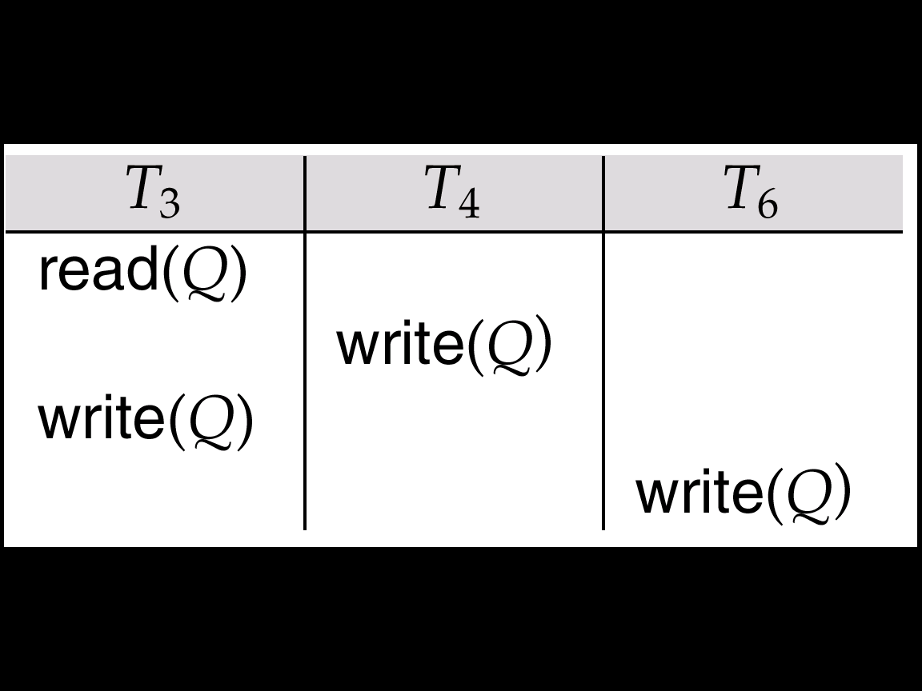
View Serializability (Cont.)
If a schedule S is view serializable, it is view equivalent to a serial schedule.
Every conflict serializable schedule is also view serializable.
A schedule which is view-serializable but not conflict serializable. Equivalent to T₃, T₄, T₆
Every view serializable schedule that is not conflict serializable has blind writes - write without read
Write(Q)
Write(Q)

Slide 25
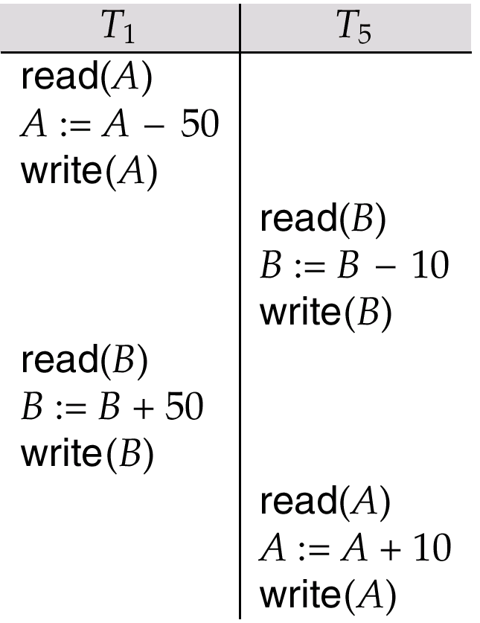
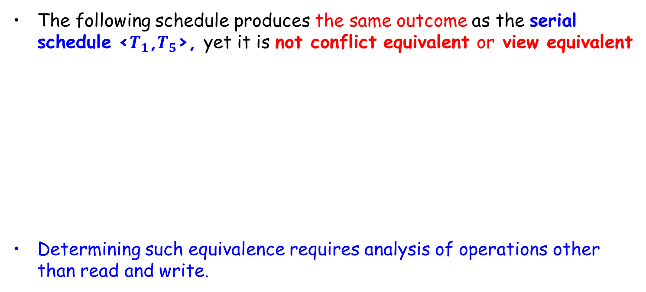
Other Notions of Serializability
The following schedule produces the same outcome as the serial schedule <$T_{1}$,$T_{5}$>, yet it is not conflict equivalent or view equivalent
Determining such equivalence requires analysis of operations other than read and write.

Slide 26
Outline
Transaction Concept
Schedules
Serializable Schedule
☞ Recoverable Schedule
Testing for Serializability

Slide 27
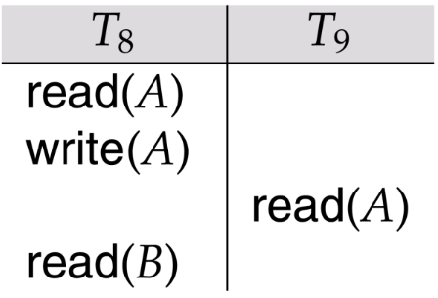

Recoverability (可恢复性)
Recoverable schedule（可恢复调度）
  If a transaction $T_{j}$ reads a data items previously written by a transaction $T_{i}$, the commit operation of $T_{i}$ appears before the commit operation of $T_{j}$
  The following schedule is not recoverable if T₉ commits immediately after the read

Slide 28
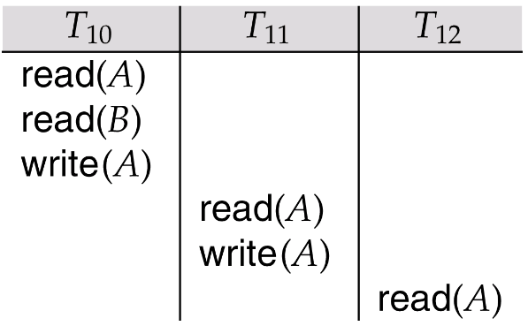
Recoverability (Cont.)
Cascading rollback(级联回滚)
  A single transaction failure leads to a series of transaction rollbacks
  Consider the following schedule where none of the transactions has yet committed
  If T₁₀ fails, T₁₁ and T₁₂ must also be rolled back
Can lead to the undoing of a significant amount of work

Slide 29
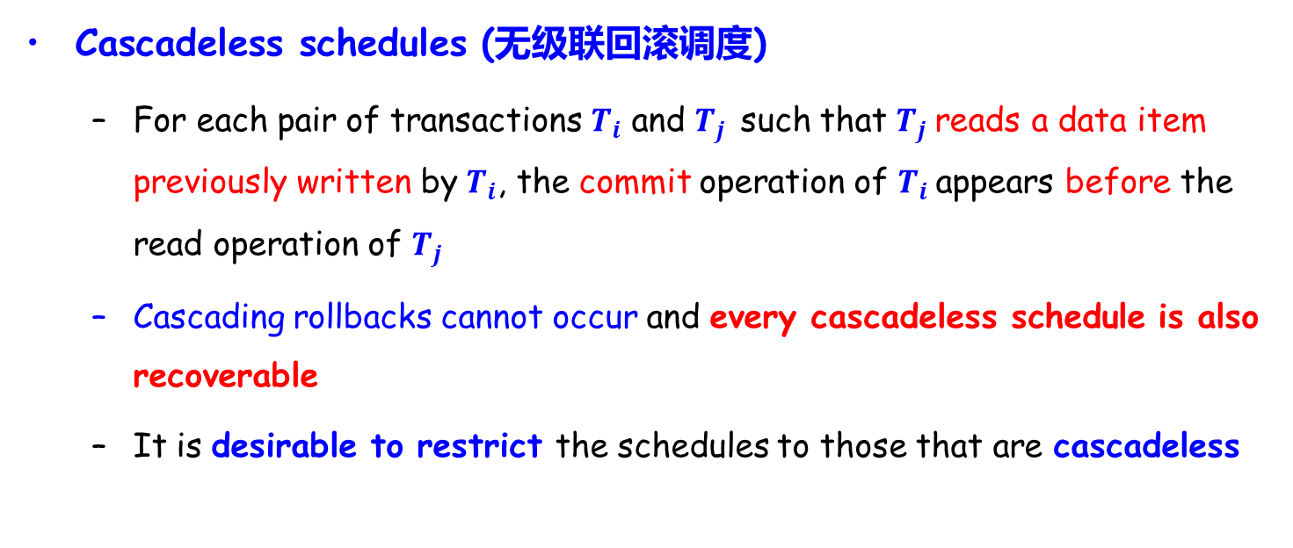
Recoverability (Cont.)
Cascadeless schedules (无级联回滚调度)
  For each pair of transactions $T_{i}$ and $T_{j}$ such that $T_{j}$reads a data item previously written by $T_{i}$, the commit operation of $T_{i}$appears before the read operation of $T_{j}$
  Cascading rollbacks cannot occur and every cascadeless schedule is also recoverable
  It is desirable to restrict the schedules to those that are cascadeless

Slide 30
Transaction Definition in SQL
DML must include a construct for specifying the set of actions that comprise a transaction
In SQL, a transaction begins implicitly
A transaction in SQL ends by:
  Commit work: commits current transaction and begins a new one.
  Rollback work: causes current transaction to abort.
Levels of isolation specified by SQL-92
  Serializable – default：保证可串行化调度
  Repeatable read：只允许读取已提交数据，两次读取之间数据不能更新
  Read committed：只允许读取已提交数据，不要求可重复读
  Read uncommitted：允许读取未提交数据

Slide 31
Outline
Transaction Concept
Schedules
Serializable Schedule
Recoverable Schedule
☞ Testing for Serializability

Slide 32
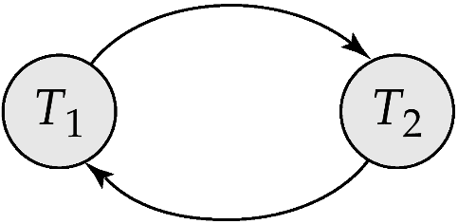
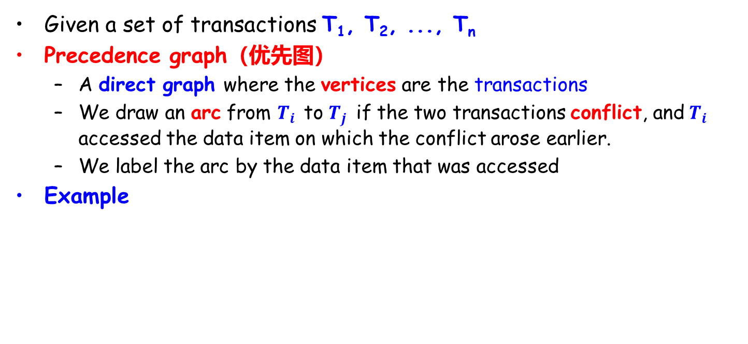
Testing for Serializability
Given a set of transactions T₁, T₂, ..., T_{n}
Precedence graph（优先图）
  A direct graph where the vertices are the transactions
  We draw an arc from $T_{i}$ to $T_{j}$ if the two transactions conflict, and $T_{i}$ accessed the data item on which the conflict arose earlier.
  We label the arc by the data item that was accessed
Example
x
T1 write(x) before T2 read(x)
T1 write(x) before T2 write(x)
T1 read(x) before T2 write(x)
T2 write(y) before T1 read(y)
T2 write(y) before T1 write(y)
T2 read(y) before T1 write(y)
y

Slide 33
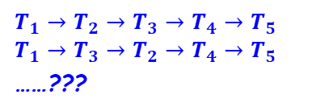
Example Schedule A
T₁ T₂ T₃ T₄ T₅
read(X)
read(Y)
read(Z)
read(V)
read(W)
read(W)
read(Y)
write(Y)
write(Z)
read(U)
read(Y)
write(Y)
read(Z)
write(Z)
read(U)
write(U)
Y
T₁
T₂
Y,Z
Y
Z
T₃
T₄
Z
$$T_{1}→T_{2}→T_{3}→T_{4}→T_{5}$$
$$T_{1}→T_{3}→T_{2}→T_{4}→T_{5}$$
……???

Slide 34
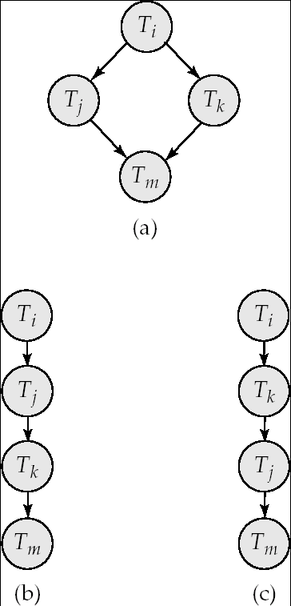
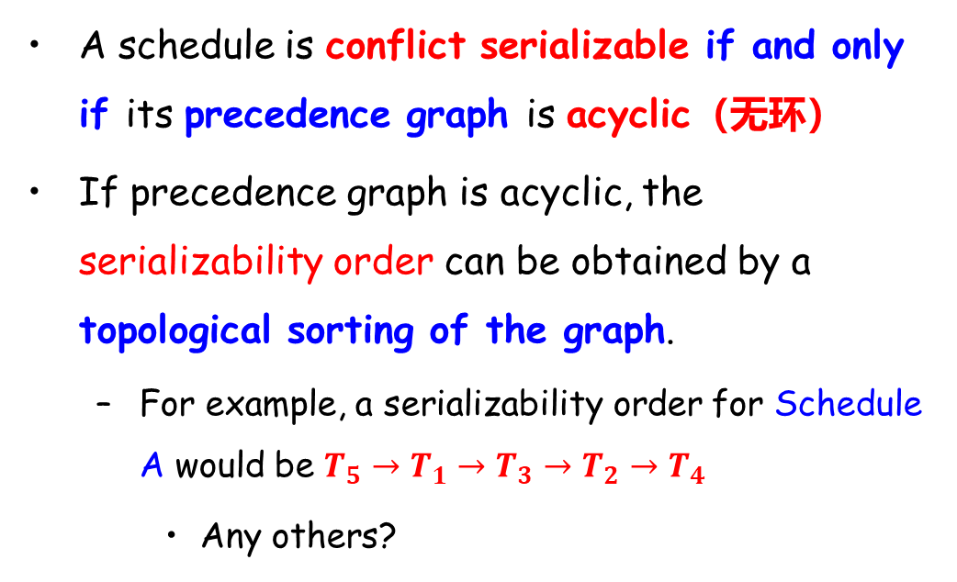
Test for Conflict Serializability
A schedule is conflict serializable if and only if its precedence graph is acyclic（无环）
If precedence graph is acyclic, the serializability order can be obtained by a topological sorting of the graph.
  For example, a serializability order for Schedule A would be $T_{5}→T_{1}→T_{3}→T_{2}→T_{4}$
    Any others?

Slide 35
Concurrency Control vs. Serializability Tests
Testing a schedule for serializability after it has executed is too late
Goal – to develop concurrency control protocols that will assure serializability.
  They will generally not examine the precedence graph as it is being created
  Instead a protocol will impose a discipline that avoids non-seralizable schedules
Tests for serializability help understand why a concurrency control protocol is correct

Slide 36
End of Lecture 17

